Slide 1


Institute of Advanced Computing and Software Development, Pune
Post Graduation Diploma in Big Data Analytics
Feb-2020
Music Genre Classification
By :
Mr. Nikhil Jadhao - 3121
Mr. Ashutosh Salunkhe - 1342
Project Guide :
Mr. AKASHY TILEKAR

Slide 2
Contents
Objectives
Introduction
Flow of execution and Flowchart
Requirements
Dataset Description
Electronic design automation(EDA)
Model and Algorithm
Result
Conclusion

Slide 3
Introduction
Classification using Machine Learning techniques, the work conducted gives an approach to classify music automatically by providing tags to the songs present in the user's library. It explores both Neural Network and traditional method of using Machine Learning algorithms and to achieve their goal.

Slide 4
Objective
Developing a machine learning model that classifies music into genres shows that there exists a solution which automatically classifies music into its genres based on various different features, instead of manually entering the genre.
Another objective is to reach a good accuracy so that the model classifies new music into its genre correctly
This model should be better than at least a few preexisting models

Slide 5
Flow of Execution
Loading .wav files.
Extracting spectrograms and Features.
Algorithm selection.
Model Building.

Slide 6
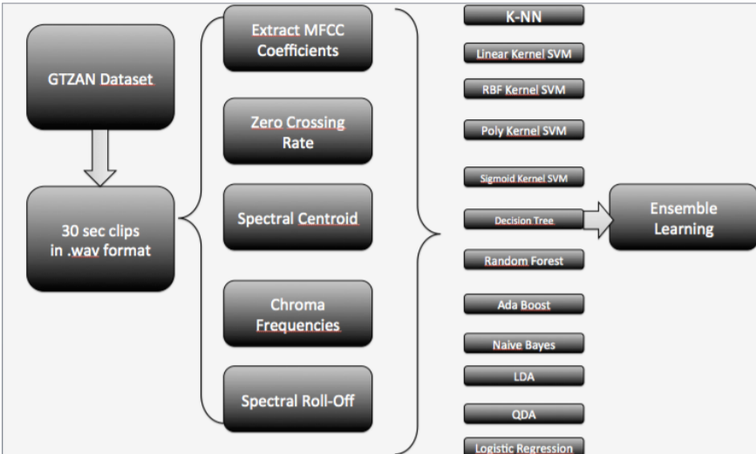
Diagrammatic Representation of Execution

Slide 7
Requirements
Data set : GTZAN genre collection dataset
Software : Google colab
Programming language: Python and Machine learning
Libraries: 1)Data visualization: Librosa and Matplotlib
2)Machine learning: Sklearn , pandas,
numpy .

Slide 8
Dataset Description
The GTZAN genre collection dataset was collected in 2000-2001. It consists of 1000 audio files each having 30 seconds duration. There are 10 classes ( 10 music genres) each containing 100 audio tracks. Each track is in .wav format. It contains audio files of the following 10 genres:
Blues
Classical
Country
Disco
Hip-hop
Jazz
Metal
Pop
Reggae
Rock

Slide 9
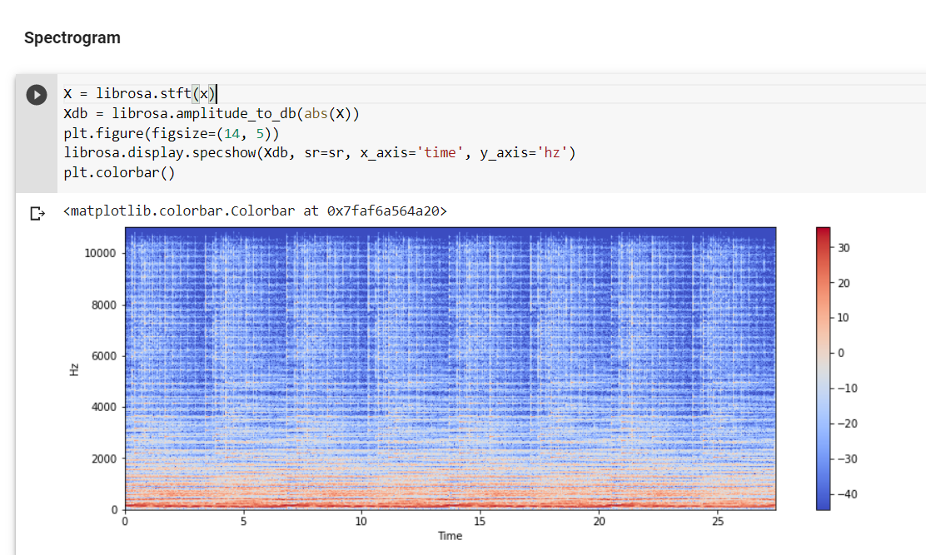
EDA
Spectrogram

Slide 10
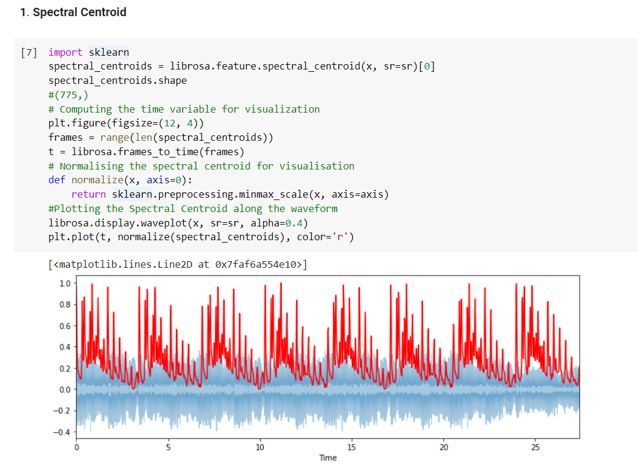
Features of audio

Slide 11
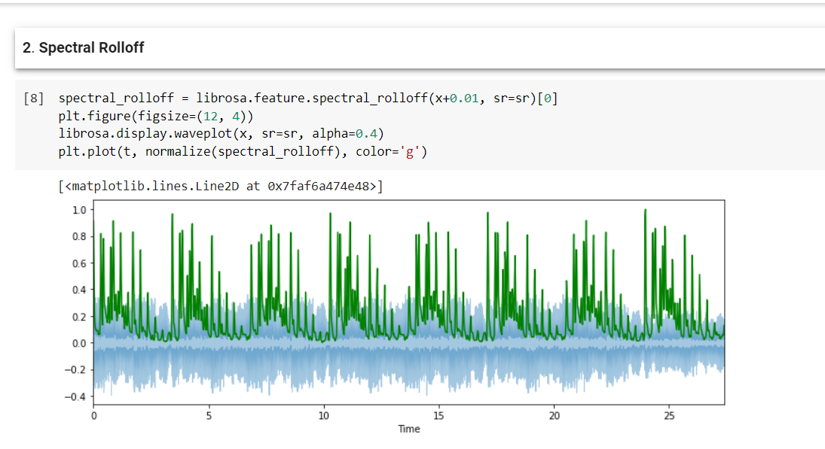

Slide 12
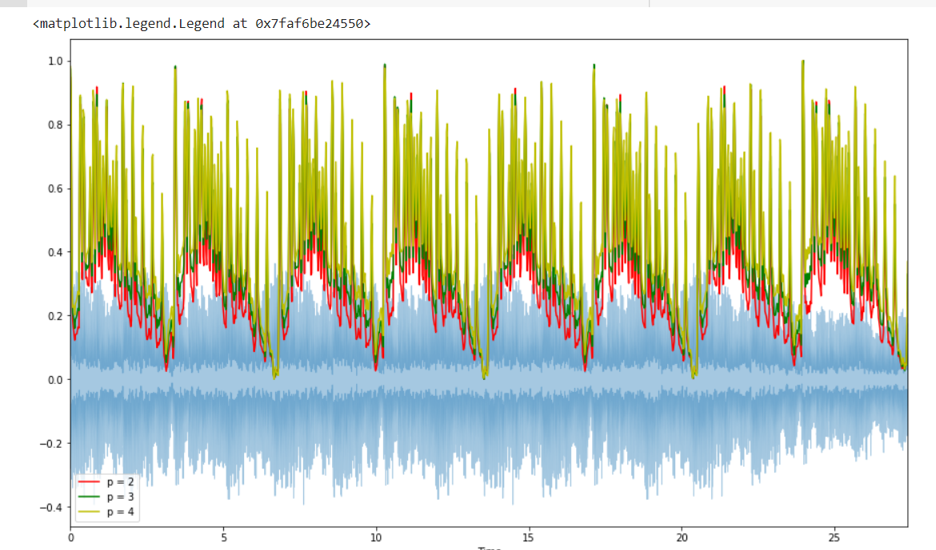
3. Spectral Bandwidth

Slide 13
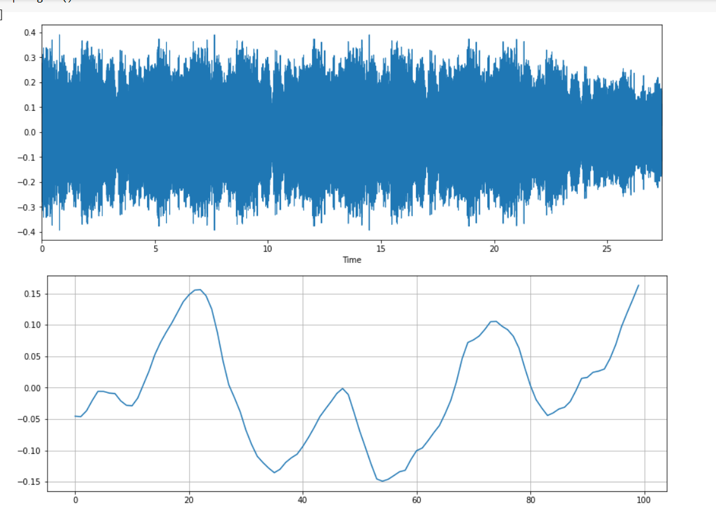
4. Zero-Crossing Rate

Slide 14
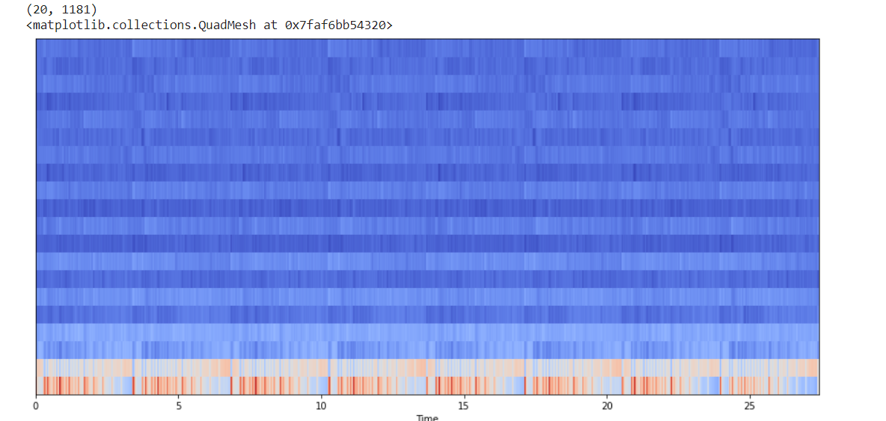
5. MFFCs

Slide 15
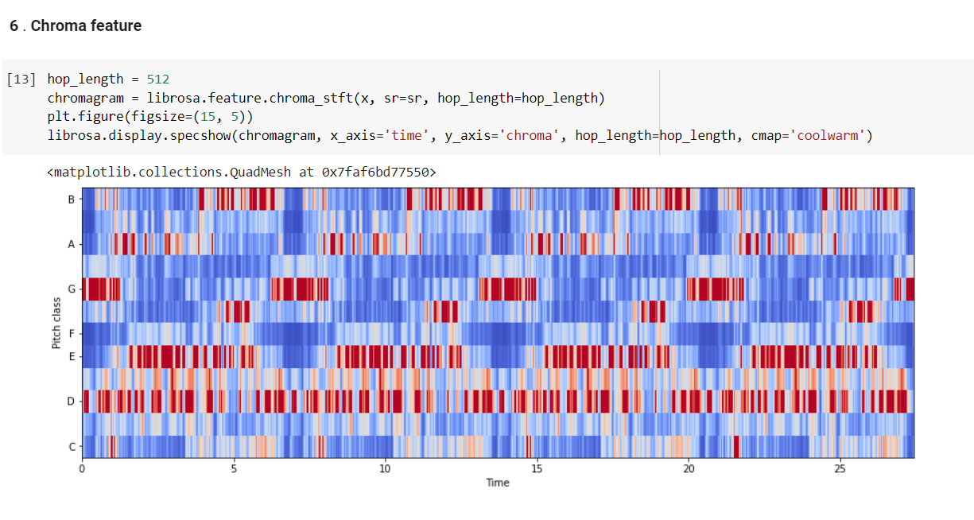

Slide 16
Model and Algorithms
Algorithms :
K-NN Classification.
Logistic Regression.
Random Forest.
SVM.

Slide 17
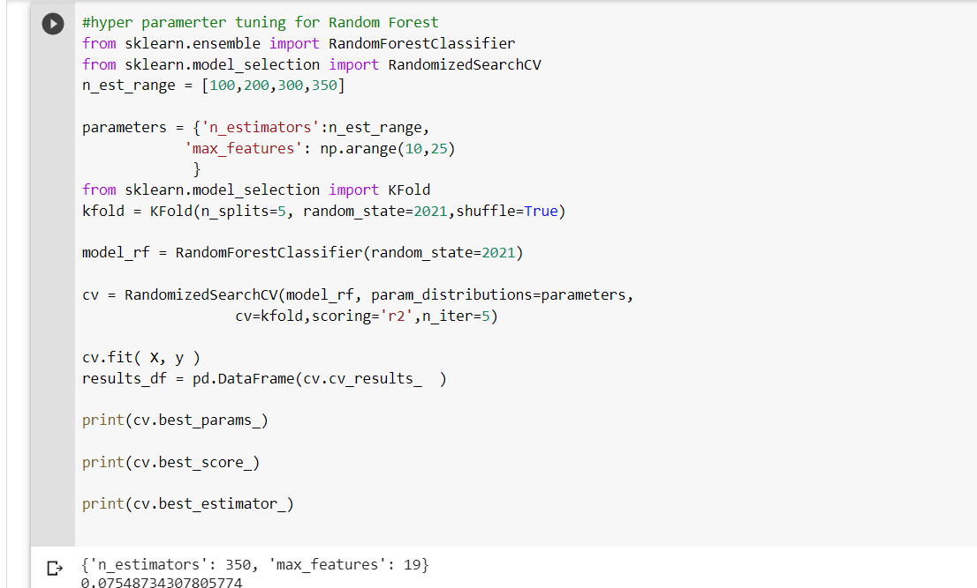
Compare Models
Random forest

Slide 18
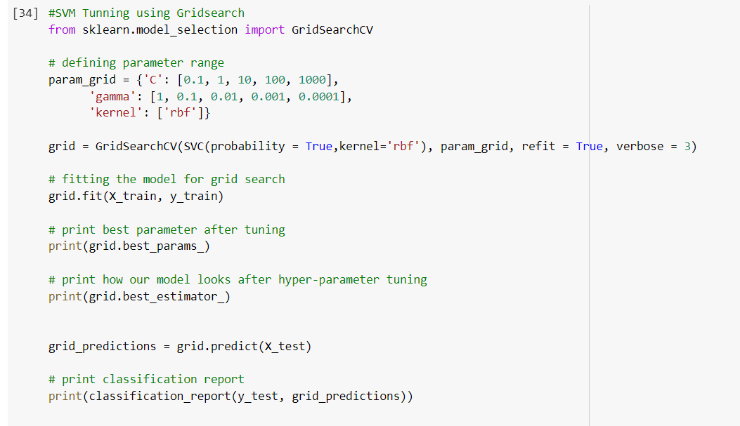
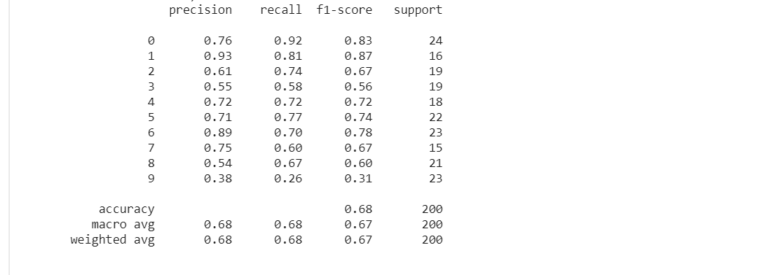
SVM

Slide 19
Selection of Model
After comparing model , the best accuracy we got by random forest
So, random forest was implement.
Than we predict the output.

Slide 20
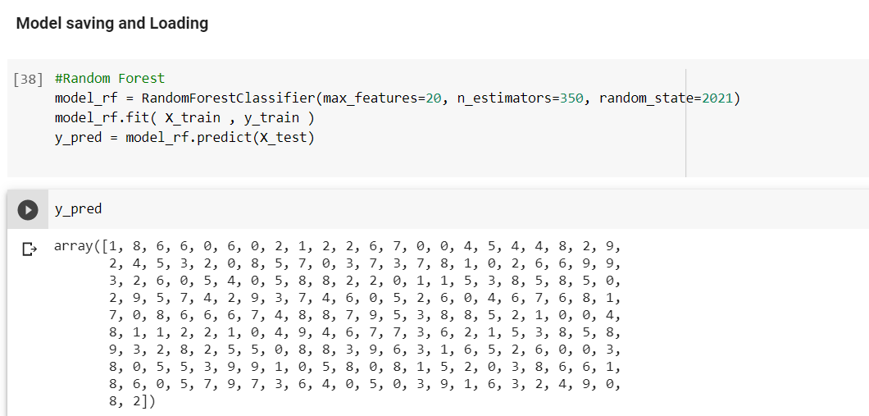
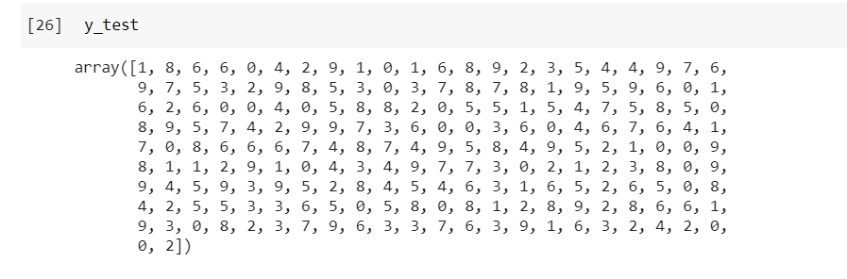
Results

Slide 21
Conclusion
In this music genre classification project, we have developed a classifier on audio files to predict its genre. We work through this project on GTZAN music genre classification dataset. This project explains how to extract important features from audio files. In this project is based on automated system for music genre classification. MFCC features, Chroma features, spectral centroid, spectral roll-off, ZCR are used as the feature vectors and trained the system using classifiers like k-NN, Logistic Regression, Random Forest and Support Vector Machine. The below table represent the accuracy before and after tunning model.

Slide 22
The below table represent the accuracy before and after tunning model.
We found that Random Forest classifier giving accuracy of 75.54% which is highest compare to other model used so Random Forest Classifier is used .
Models | Accuracy | Accuracy after tunning
K-Nearest Neighbor (K-NN) | 62.50% | 64.75%
Logistic Regression (LR) | 64.23% | 65.13%
Random Forest (RF) | 64.45% | 75.54%
Support Vector Machines (SVM) | 65.50% | 73%

Slide 23
Future Scope
Can be used for Recommendation system to recommend the genre.
More features can be used like tempo, pitch etc. for better accuracy which will give as better classification .
Using Spectrogram we can Implement Deep Learning method which can be used like Convolutional Neural Networks which can give as better performance.

